Slide 1
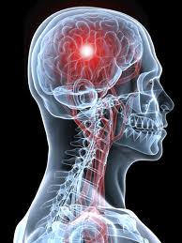
STROKE: AN OVERVIEW
Dr Aaron de Souza
MD, DM, DNB, MNAMS
Consultant Neurologist,
Manipal Goa Hospital

Slide 2
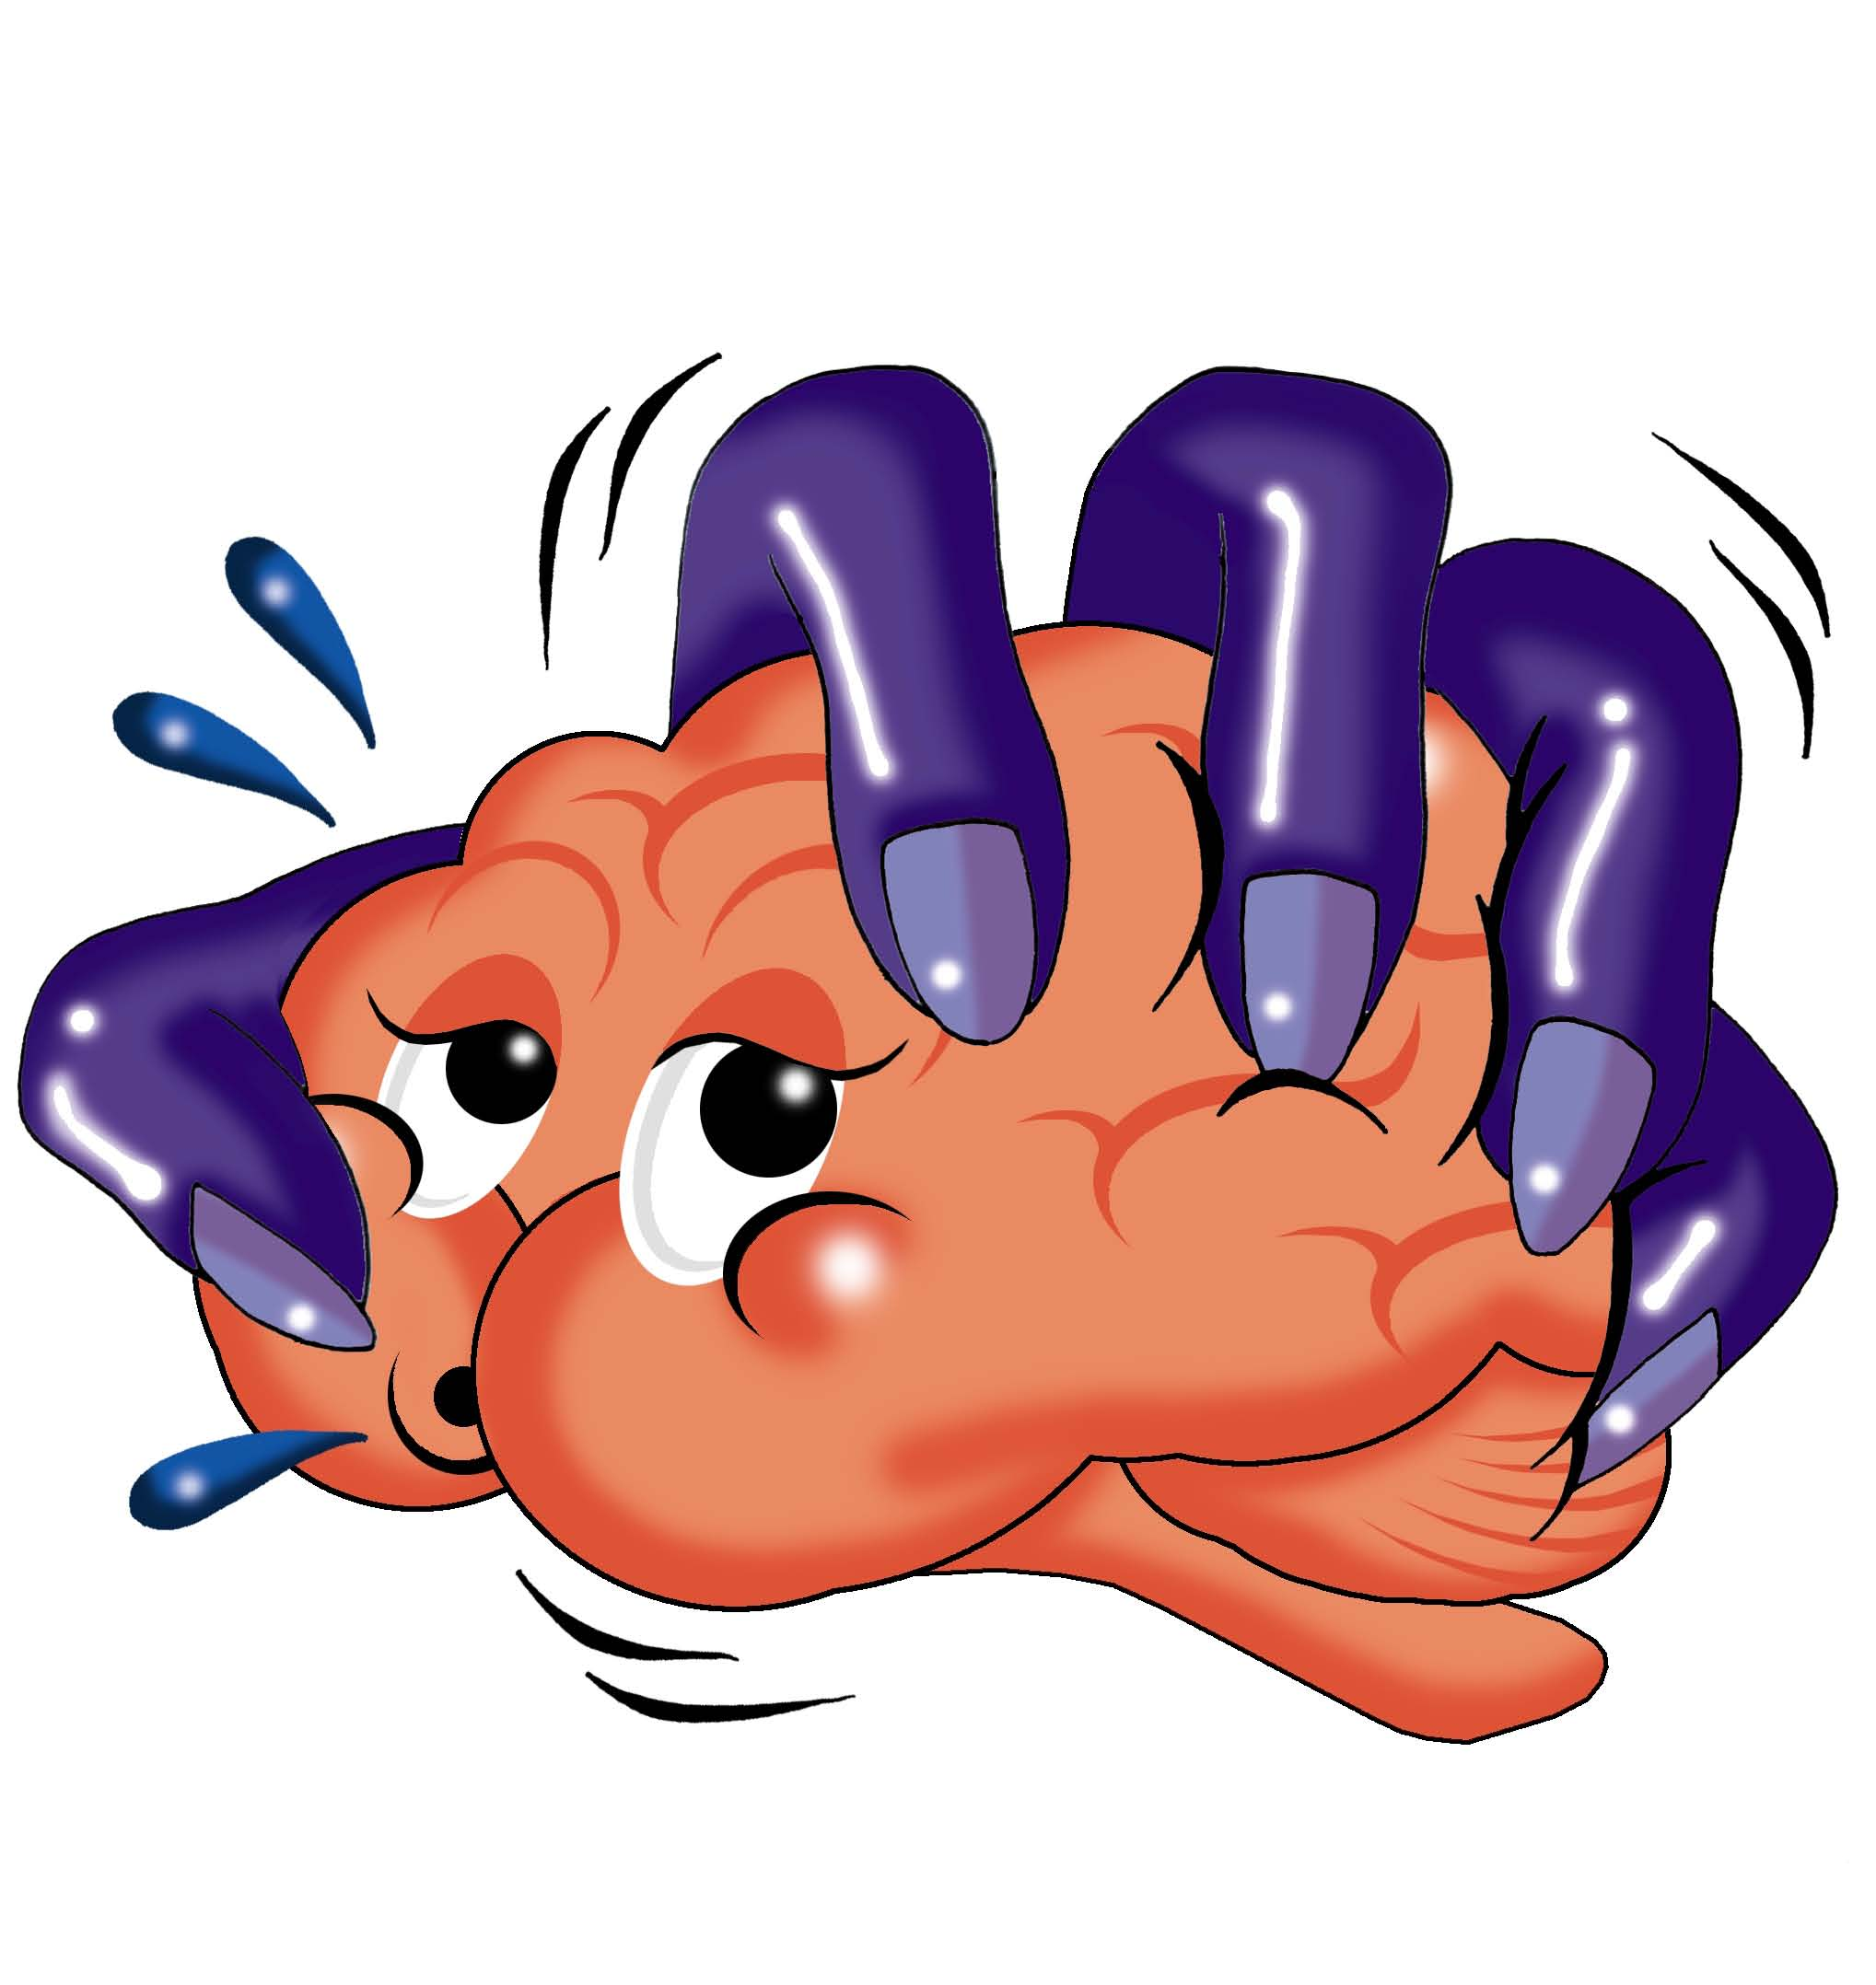
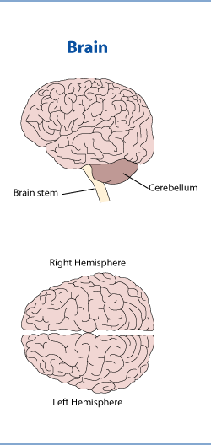
Stroke: Brain Attack
Sudden loss of function of a part of the brain
Due to a problem with blood supply

Slide 3
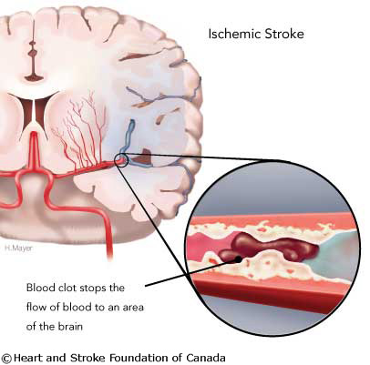
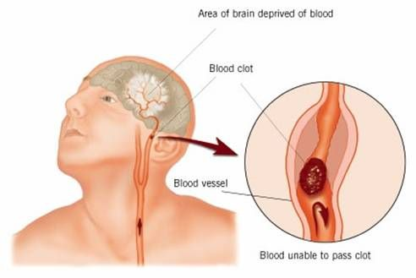
Types of Stroke
Loss of blood supply to a part of the brain: Ischaemic (85%)
Bleeding within brain matter: Haemorrhagic (15%)

Slide 4
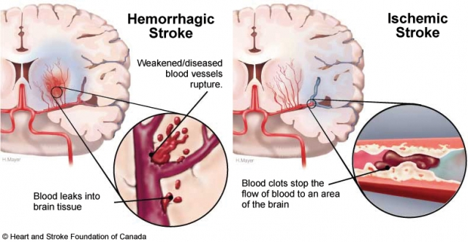
Types of Stroke

Slide 5
Not a Single Disease: Stroke Subtypes and Incidence
Hemorrhagic stroke 15%
Other 5%
Unknown cause 30%
Atherosclerotic
cerebrovascular
disease
20%
Small vessel
disease
“lacunes”
25%
Cardiac disease 20%
Ischaemic stroke 85%
Albers G et al. Chest. 2001; 119 (suppl): 300S.

Slide 6
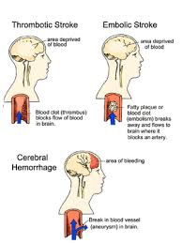
Thrombosis
Embolism
Haemorrhage

Slide 7
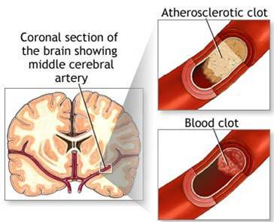
Atherosclerosis and stroke

Slide 8
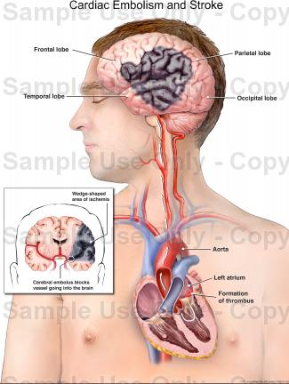
Cardiac Embolism

Slide 9
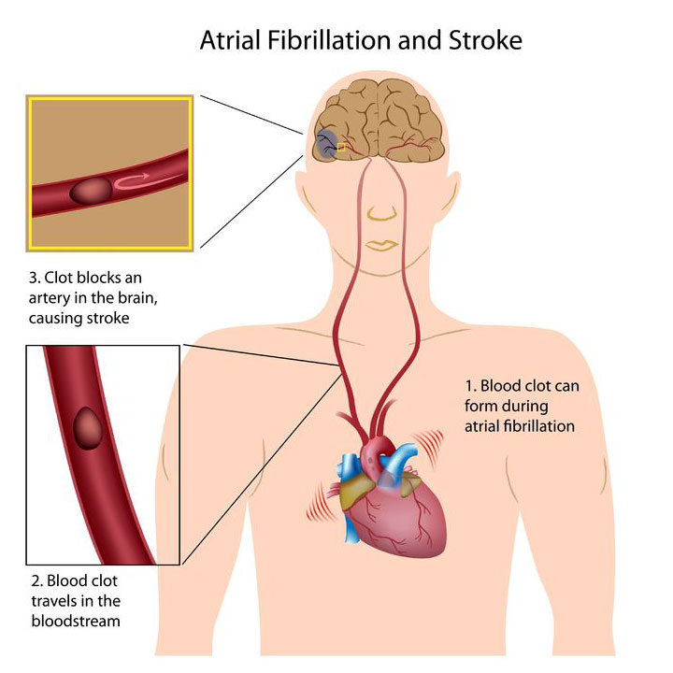

Slide 10
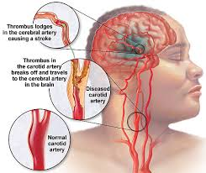
Arterial Embolism

Slide 11
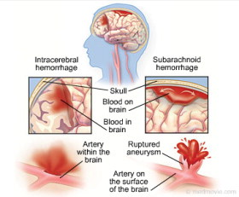

Slide 12
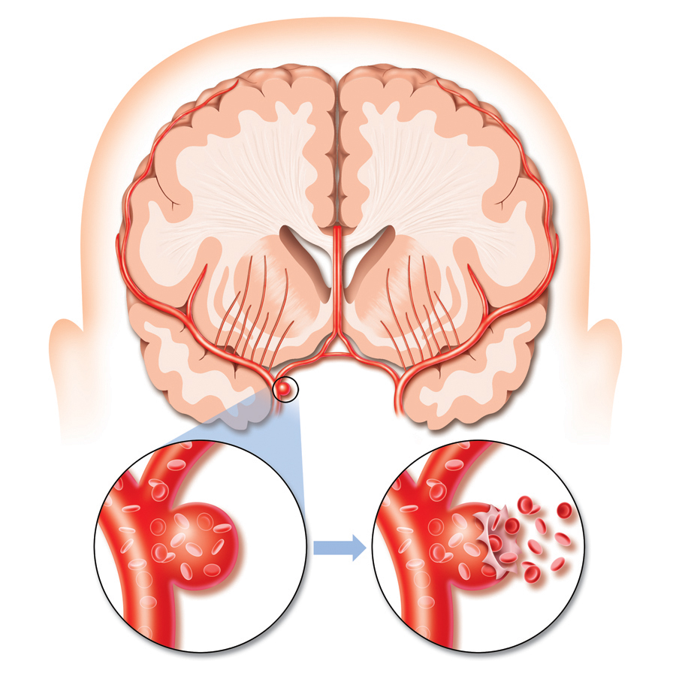
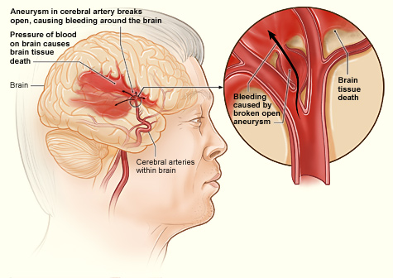
Aneurysms and cerebral haemorrhage

Slide 13
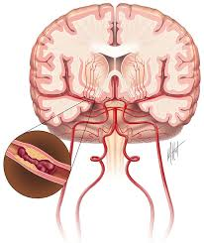
Why is Stroke Important?
Third leading cause of death
Heart disease
Cancer
Stroke
700, 000 strokes per year in USA;
450, 000 in Europe
Almost 8% of ischaemic and 40% of haemorrhagic strokes die in 30 days

Slide 14
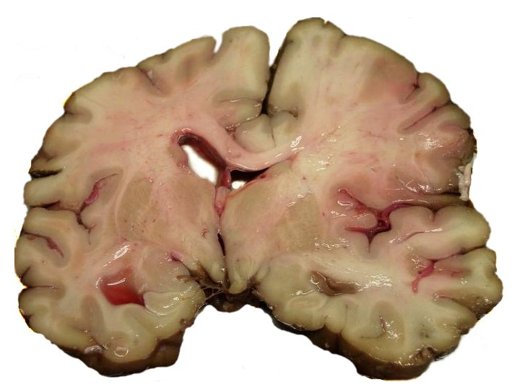

Slide 15
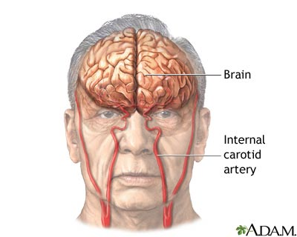
Indian Scenario
Incidence: 150 per lakh
(150 persons out of every lakh,
or 3 in each 2 000)
Most common neurologic disease after migraine and epilepsy
Of stroke patients still alive at 6months, over 30% are dependent on others for even basic functions

Slide 16
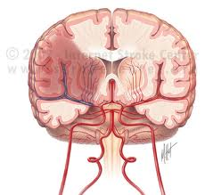
A Deadly Disease, Becoming More Frequent
Increased incidence of stroke
As the population grows older due to longer life expectancy,
Lifestyle changes in India
High incidence of diabetes

Slide 17
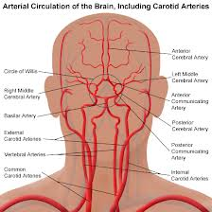
Blood supply to the brain

Slide 18
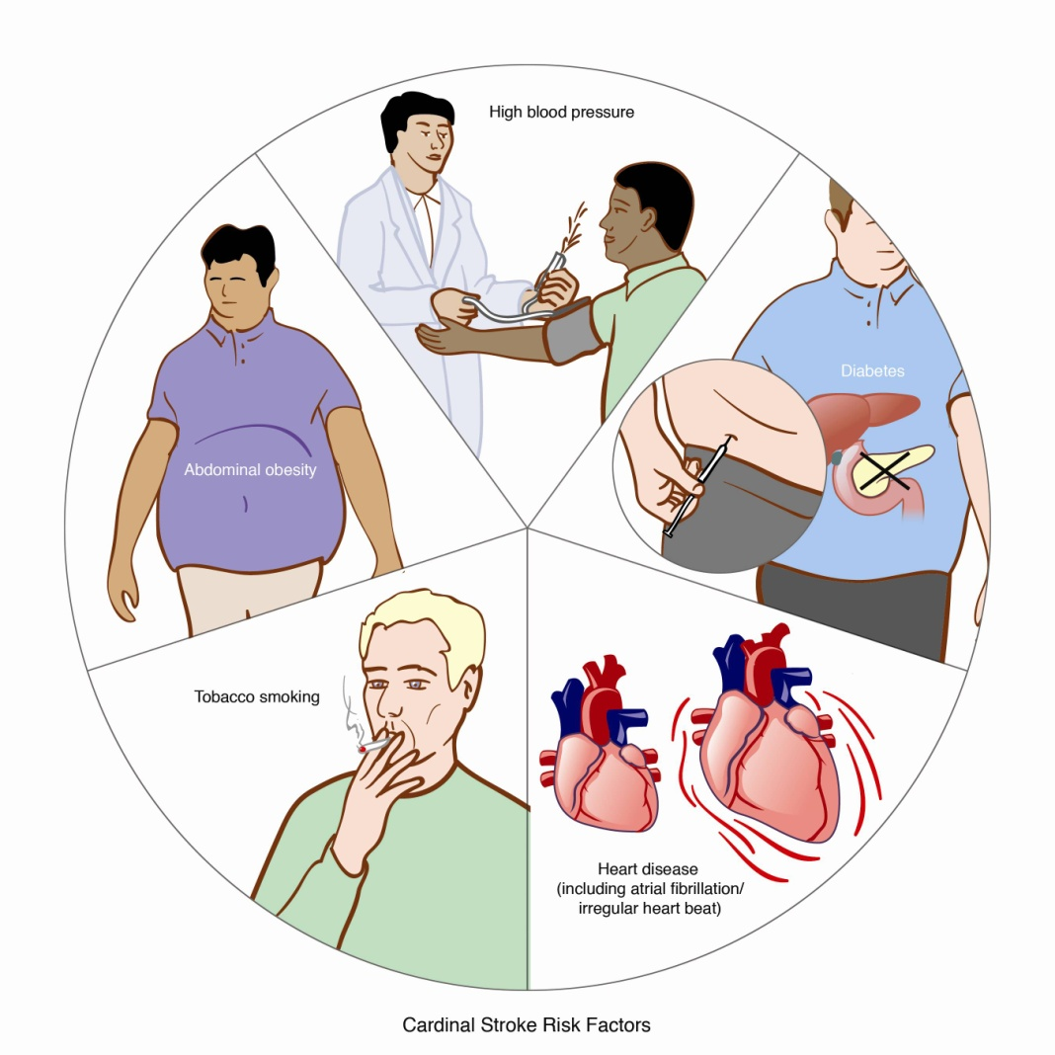
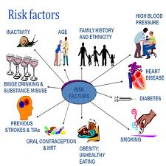
Risk Factors for Stroke

Slide 19
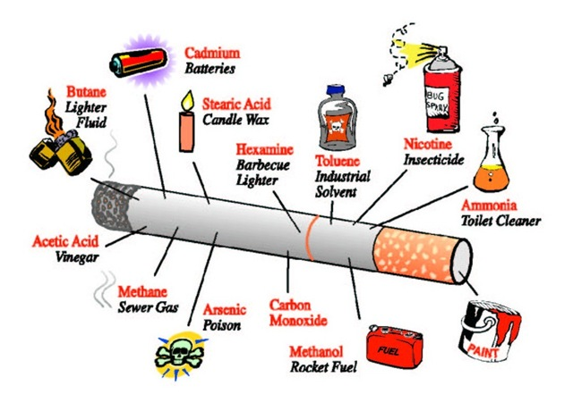
Cigarettes: potent risk factor

Slide 20
Stroke Begets Stroke
Stroke patients are most at risk of another stroke
16
Stroke
Myocardial Infarction
(Heart Attack)
14%
14
13%
13%
12
10%
10
Percent of stroke patients with subsequent events
8
7%
6
4
3%
3%
2%
2
0
CATS
TASS
CAPRIE*
ESPS 2
Trials
Previous stroke is the single most important risk factor
for stroke
Albers G. Neurology. 2000; 14(5):1022-8.

Slide 21
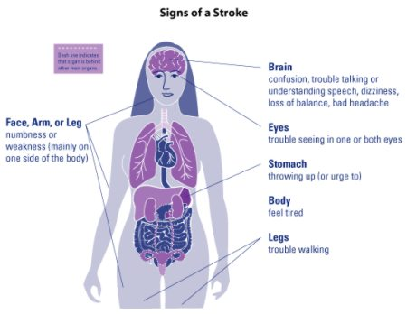

Slide 22
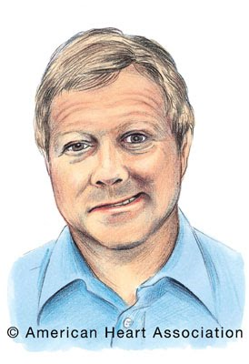
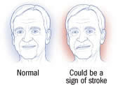
Facial Weakness

Slide 23
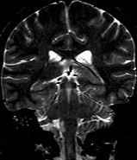
Brainstem Strokes
Motor & sensory deficits
Change in voice
Swallowing problems
Eye deviation, eye paralysis
Loss of consciousness
Gait change (“drunken” gait)
Vertigo / dizziness

Slide 24
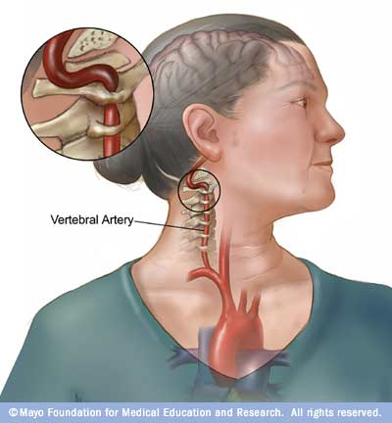

Slide 25
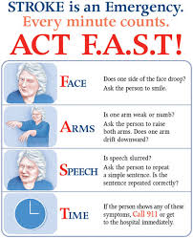

Slide 26
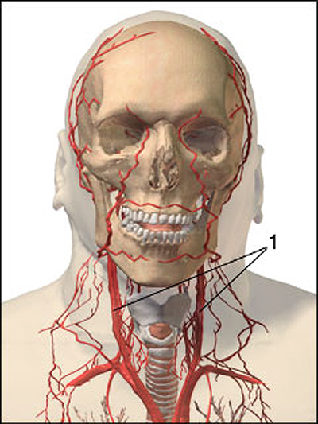
Investigations / Lab Tests
CT scan head
ECG, Echocardiogram
Hemogram
Blood Glucose, Lipid profile
Carotid doppler.
MRI
Diffusion Weighted MRI
(DWI), Perfusion-CT and MRI(PWI)

Slide 27
Uses of CT
Usual first investigation
Plain & Contrast
Exclude intracranial haemorrhage
Exclusion of extensive ischemic infarctions.

Slide 28
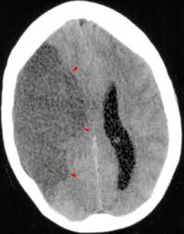
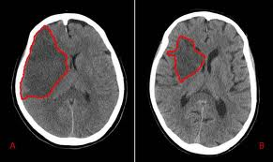
CT scan in stroke

Slide 29
CT scan in intracerebral haemorrhage

Slide 30
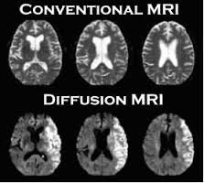
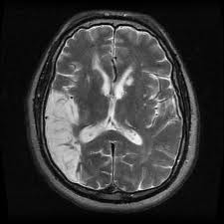
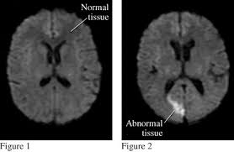
MRI in stroke
T2 weighted / Diffusion

Slide 31
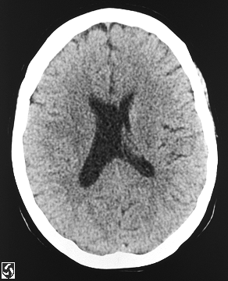
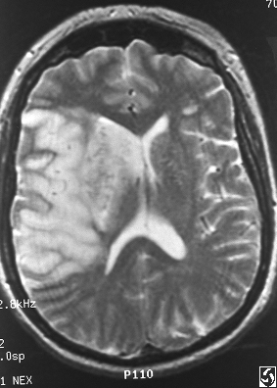
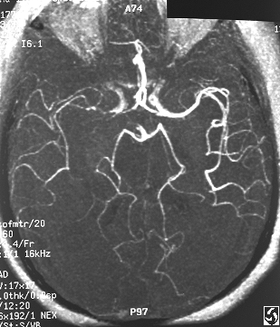
CT vs MRI / MRA

Slide 32
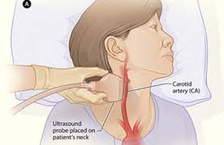
Doppler Studies
Special ultrasound
examination for arteries in the neck
Detects clot or narrowing
Helps plan treatment to prevent recurrent stroke.

Slide 33
Treatment
Primary Prevention
Persons who have never had a stroke
Secondary Prevention
Persons with stroke, to prevent another
Treatment of acute stroke
Treatment of chronic stroke

Slide 34
Primary Prevention
Modify stroke risk factors (BP, diabetes, cholesterol)
Stop smoking
Exercise
Tablets for BP or cholesterol
Anticoagulation for heart disease

Slide 35
Secondary Prevention
Aspirin
Other meds (clopidogrel)
Carotid artery surgery if block found
Treat heart disease if present

Slide 36
Treatment of acute stroke
Within 3 hours of onset: IV Alteplase/tPA
Many conditions to be fulfiled before use
Treat brain swelling
Treat complications of unconsciousness / immobility

Slide 37
Intravenous Thrombolysis
Uses tPA/alteplase
Reduces risk of long-term deficits due to stroke, speeds up recovery
Risky: can cause severe bleeding
Strict conditions for use
Patient must reach hospital <3hours after onset

Slide 38
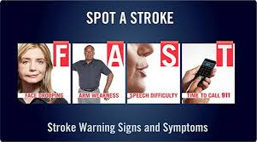
“Brain Attack”
As much of an emergency as heart attack
A few minutes can make lots of difference to outcome
Get the patient to hospital FAST

Slide 39
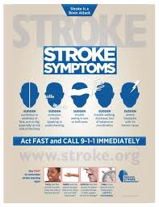

Slide 40
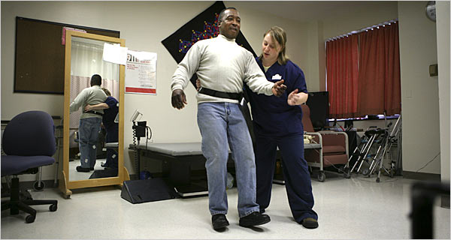
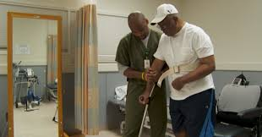
Treatment of Chronic Deficits
Neurological rehabilitation
Physiotherapy
Medicines to relieve stiffness
Surgery for limb deformities
Botox injections
Newer machines developed for faster recovery

Slide 41
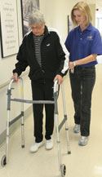
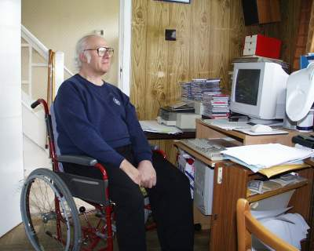
Social Rehabilitation
Prolonged recovery after stroke
Many patients with severe deficits in
the community
Need vocational training
Family needs counselling

Slide 42
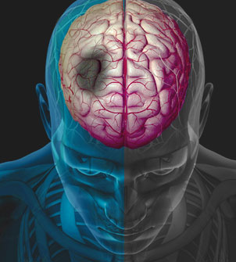
TIA
Transient: short lived (<1 day)
Ischaemic: lack of blood flow
Attack: weakness, numbness, speech, blindness
Warning sign of future stroke risk
Should NEVER be ignored
Treatment with aspirin

Slide 43
Stroke Services at Manipal Hospital
Department of Neurology
Backed up by 24hr CT, MRI services
Intravenous thrombolysis
Facilities for rehabilitation
Research into strokes in Goa.

Slide 44
Take Home Points
Stroke is a common disease
Warning signs of stroke should always be treated
Lifestyle modifications and control of risk factors
Acute stroke: IMMEDIATE transfer to hospital
Chronic stroke: needs long term rehabilitation

Slide 45
